Slide 1

CAPSTONE PROJECT FINAL REVIEW Customer Churn Prediction using ANN
Name : Tushar Maurya
Register No:19BCE1856
Programme & Specialization : B.Tech CSE
Guide Name:
Dr. K. Sathyarajasekaran

Slide 2
Outline
Introduction
Background Work, Challenges
Problem Statement
Research Objective
Proposed System
Introduction
Diagram
Modules
Explanation of Modules
Result
Guide Approval mail snapshot
Research Paper Status
References

Slide 3
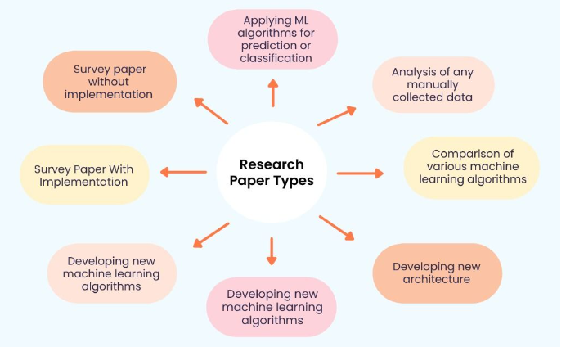

Slide 4
Introduction
Businesses around the world are evolving every day which has drastically led to the growth of two major fields Artificial intelligence and Machine Learning.
Technology based on AI and ML has recently developed to such an extent that it has become an essential element of the largest online stores on the web.
Most of the work in the online store is automized.

Slide 5
Other fields where ML and AI have achieved excellence:-
Speech recognition(Voice search, appliance control, Alexa Home, Google Home)
Virtual Assistant(Alexa, Siri)
Image recognition(facial, non-living things)
Google Translation(Language translation)
Traffic Alerts in Google Maps
Self-driving cars(Waymo)
Medical diagnosis
Predictive analytics(Loan prediction, SIP amount prediction)
Recommender System(Music and movie Recommendations)

Slide 6
Background Work, Challenges
The main work behind the scene is the phase of learning because it’s true that AI and ML are very vast topics.
So every day, I am learning new algorithms and focusing on building better practical models, and learning how to optimize the model in a better way because I felt in most cases the model is already prepared its about the space that is so large or the accuracy that is so bad.
I also faced issues while studying and selecting the correct material for different topics as most of the courses were either highly paid or the courses on youtube aren’t reliable.

Slide 7
The main challenge was selecting the final idea as the field is evolving at its peak because of the tech giants like Amazon, Alibaba, Flipkart, and Walmart.
Every day I read one article in the morning since I enrolled in the capstone project as working on this idea as my final project was one of my dreams when I joined the college due to the placements I was not very regular but still I was able to make ends meet.
The Research paper was not a difficult part as I was getting the idea of how to implement it by reading so much in the right direction.

Slide 8
Problem Statement
I have seen many Research papers and I found that much research work has been done in the field but still there is much more left.
Many companies have a weak working algorithm which sometimes affects their sales and they don’t even exactly know how many customers stopped buying from their website.
So, I have decided to work on the churn Prediction and not only that try including the dataset of other companies so that you don’t make a mistake. It’s true that you learn from your mistake but if others are making mistakes why not learn from them?

Slide 9
Research objectives
My main research objective is to find an ANN solution for the given problem in an optimized manner because I tried to find the Research paper’s Future Work in many of them it was mentioned the Deep Learning approach with Hyperparameter tuning. So, this approach can further lead to an optimized approach in this field.
Companies like Dunnsolution have made the E-commerce world a competitive market as they are specially providing their services in this field to have all sorts of models.
I would also like to see if the ANN could lead to some remarkable or tremendous improvement in the field of Deep Learning.

Slide 10
PROPOSED SYSTEM

Slide 13
RESULT

Slide 14
Guide Approval Snapshot

Slide 15
Research Paper Status
I have asked my Guide to publish the Research Paper. So, it’s basically in communication phase.

Slide 16
References ( Same order as Literature Review)
The Impact of Customer Satisfaction and Relationship Quality on Customer Retention: A Critical Reassessment and Model Development [1997]
Thorsten Hennig-Thurau and Alexander Klee (University of Hanover)
Churn Prediction: Does Technology Matter? [2006]
John Hadden, Ashutosh Tiwari, Rajkumar Roy, and Dymitr Ruta
Scikit-learn: Machine Learning in Python [2012]
Fabian Pedregosa, Gaël Varoquaux, Alexandre Gramfort, Vincent Michel, Bertrand Thirion, Olivier Grisel, Mathieu Blondel, Peter Prettenhofer, Ron Weiss, Vincent Dubourg, et al

Slide 17
Customer Churn Prediction in Telecommunication A Decade Review and Classification [2013]
Nabgha Hashmi ,Naveed Anwer Butt and Dr.Muddesar Iqbal
An Integrated Framework to Recommend Personalized Retention Actions to Control B2C E-Commerce Customer Churn [2015]
Shini Renjith
Predicting Shipping Time with Machine Learning. [2015]
Antoine Jonquais, Florian Krempl Advisor, Dr. Roar Adland, Dr. Haiying Jia
LightGBM: A Highly Efficient Gradient Boosting Decision Tree [2017]
Guolin Ke , Qi Meng , Thomas Finley , Taifeng Wang , Wei Chen , Weidong Ma , Qiwei Ye , Tie-Yan Liu

Slide 18
Customer Lifetime Value Prediction Using Embeddings [2017]
Benjamin Paul Chamberlain, Angelo Cardoso, C.H. Bryan Liu, Roberto Pagliari, Marc Peter Deisenroth
Introduction to artificial neural networks [2018]
Enzo Grossi , Massimo Buscema
Online Fashion Commerce: Modelling Customer Promise Date [2021]
Preethi V, Nachiappan Sundaram, Ravindra Babu Tallamraju

Slide 19
Thank You

